Slide 1
IS883: Synthesizing Digital Efforts
Mohannad Elhamod

Slide 2
The Transformer
How to solve the forgetting problem…

Slide 3
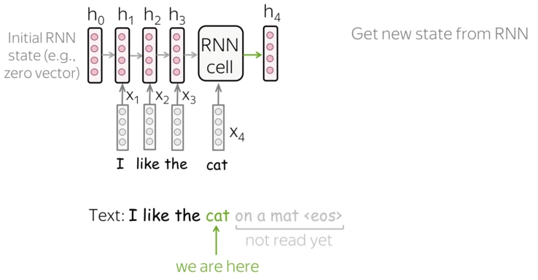
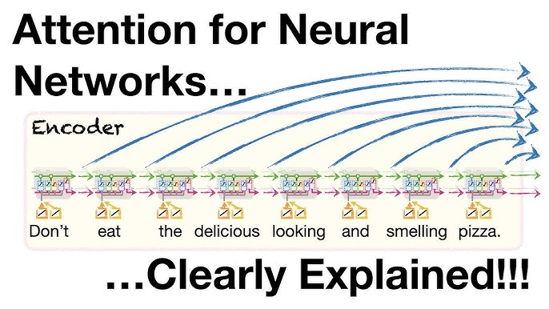
Last time on IS883…
Lena-voita
Catastrophic forgetting… !
How do we solve it?
We started with having one memorization path…
Then we added a second path (long memory and short memory).
Next…?
StatQuest

Slide 4
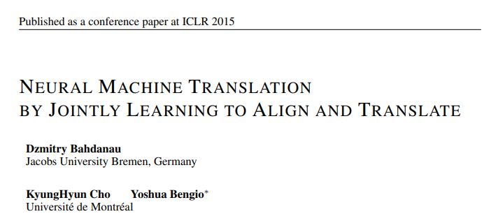
Attention!
Instead, let’s get information from all past cells!
StatQuest

Slide 5
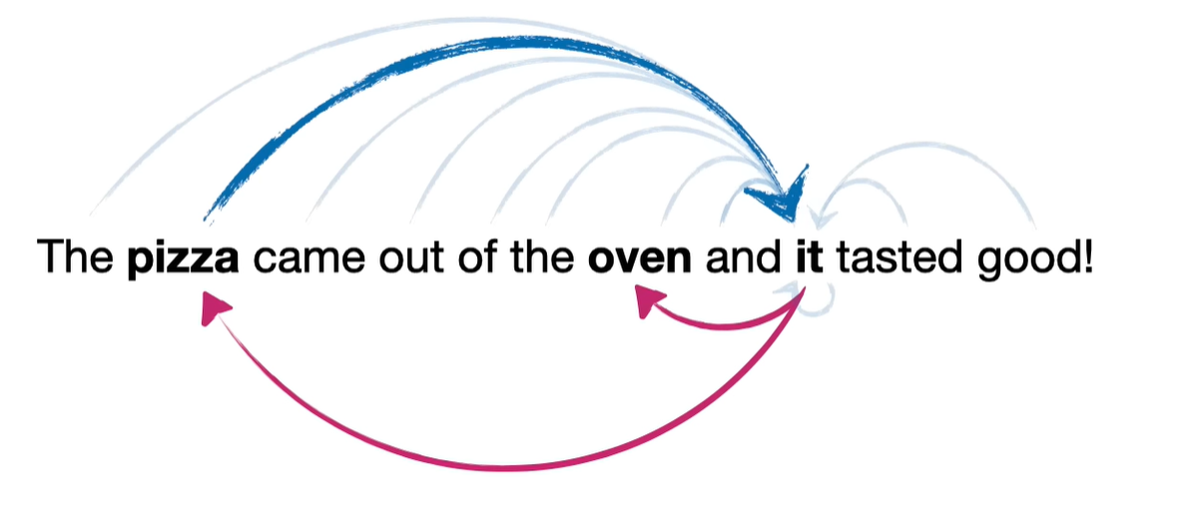
Attention!
A bit more detail:
What are we doing with this information?
We are trying to find the similarity between a previous state and the current state.
We want to pay attention to the right part of the sentence.
StatQuest

Slide 6
Attention!
What do you think the next step is?
We don’t really need the long short-term part…
We only need to calculate the attention to each token.
StatQuest

Slide 7
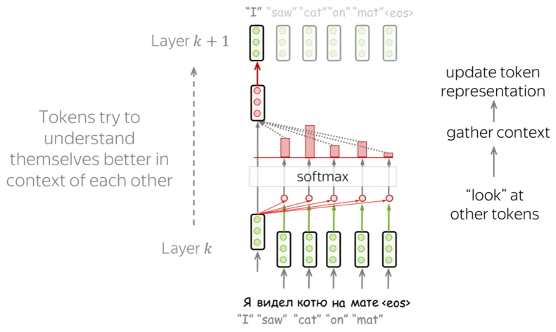
Attention!
If each state (i.e., embedding) is a vector, then similarity is calculated by?...
Dot product!
Lena-voita

Slide 8
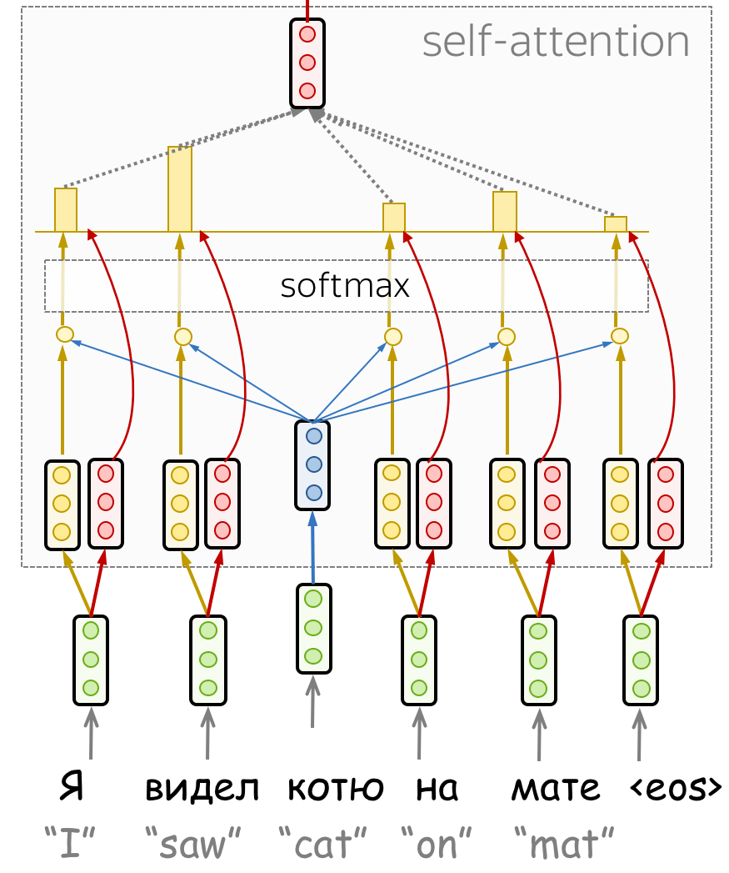
Attention!
But this only captures embedding similarity. What if I want a more nuanced notion of similarity?
Lena-voita
Notes:
e.g. verb vs subject

Slide 9
Attention!
But this only captures embedding similarity. What if I want a more nuanced notion of similarity?
Lena-voita
Query: Attention from…
Key: Attention to…
Their multiplication gives me the attention scores.
Values : used as embeddings weighted by these scores.
Notes:
e.g. verb vs subject

Slide 10
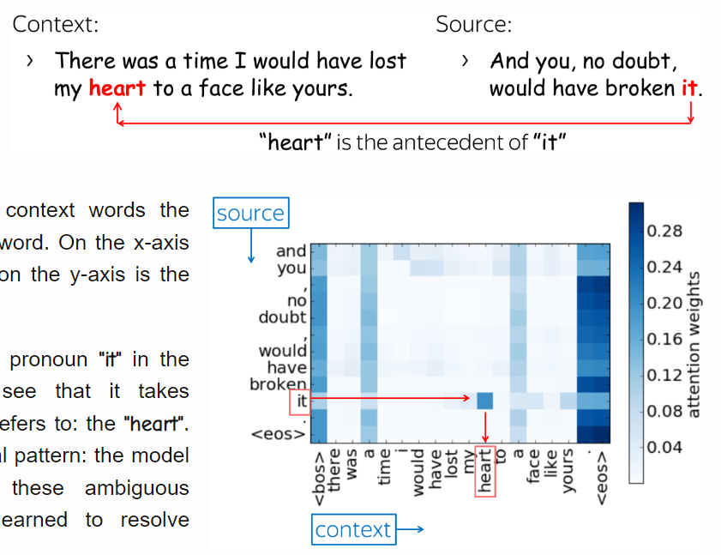
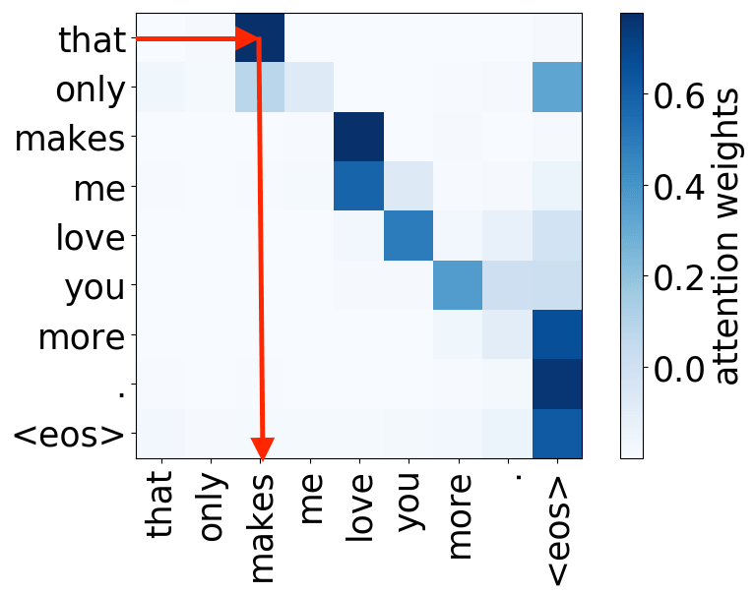
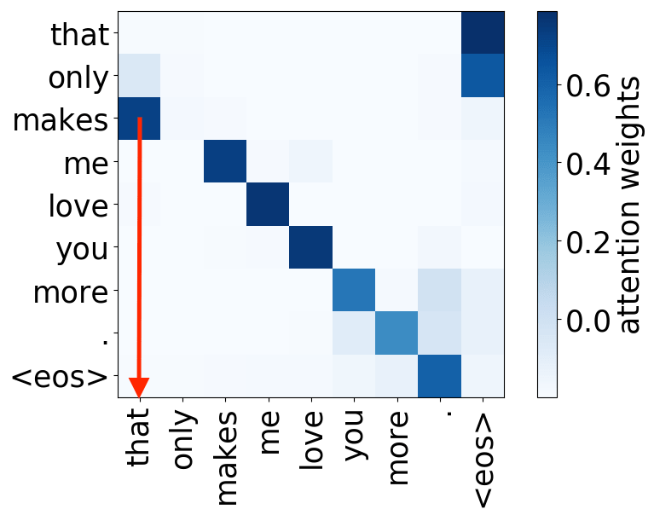
Attention!
But what if I want to capture more than one notion of “a nuance”?
Subject -> verb
Verb -> subject
Lena-voita
Notes:
e.g. verb vs subject

Slide 11
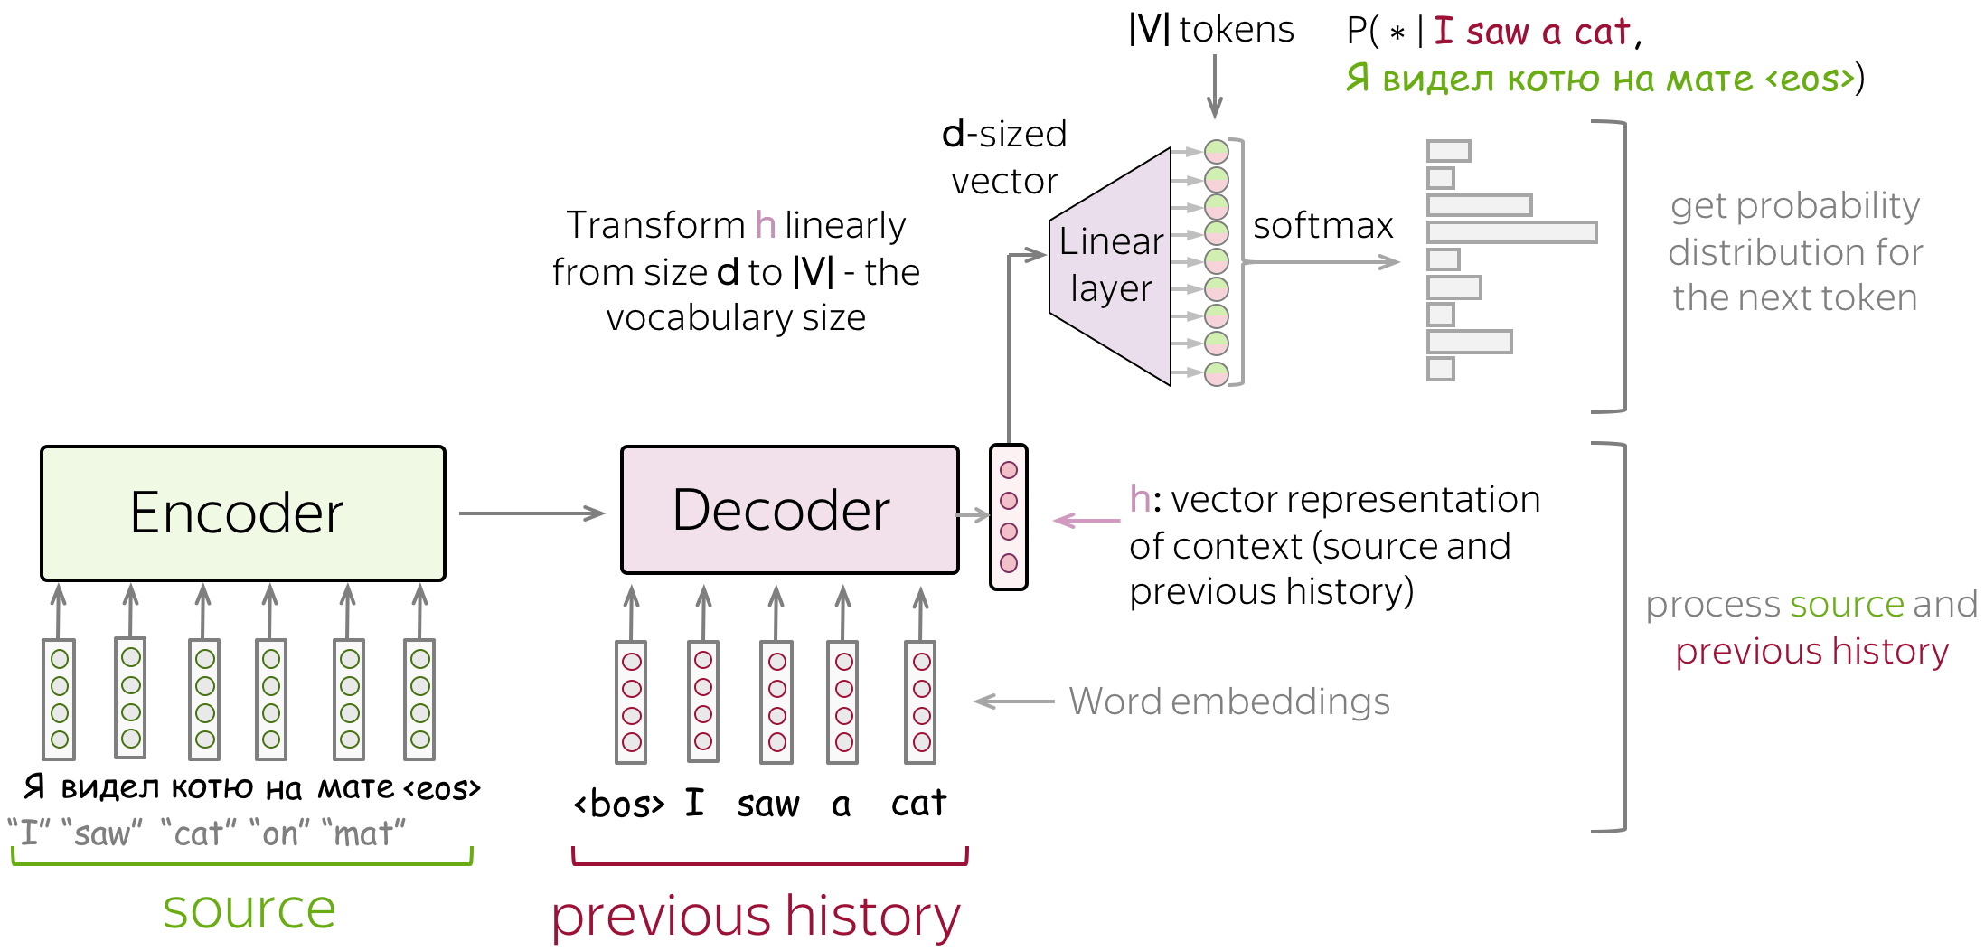
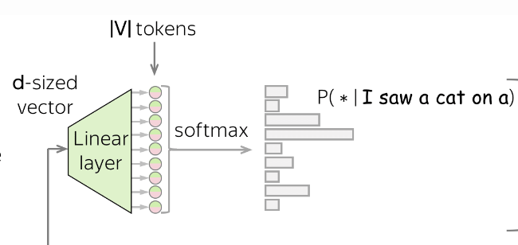
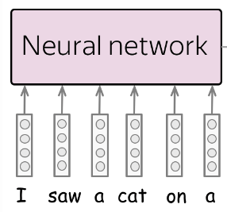

An encoder-decoder approach
Lena-voita
Notes:
Why encoder decoder: different functionalities (e.g., languages). Variable lengths.

Slide 12
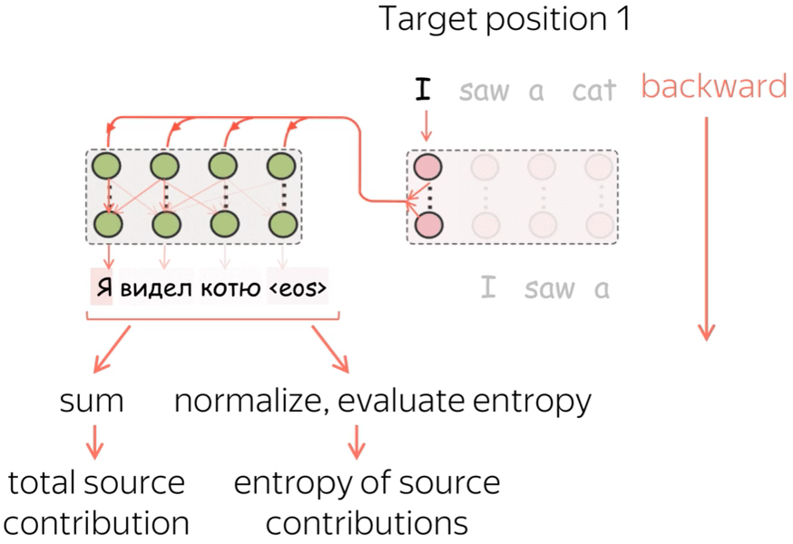
An encoder-decoder approach
Notes:
Why encoder decoder: different functionalities (e.g., languages). Variable lengths.

Slide 13
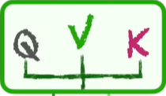
Attention!
But what if I want to capture more than one notion of “a nuance”…
StatQuest
Multi-head attention
Notes:
e.g. verb vs subject

Slide 14
Issues? (1)
What issues did we cause by removing the sequential information?
Word order!
StatQuest

Slide 15
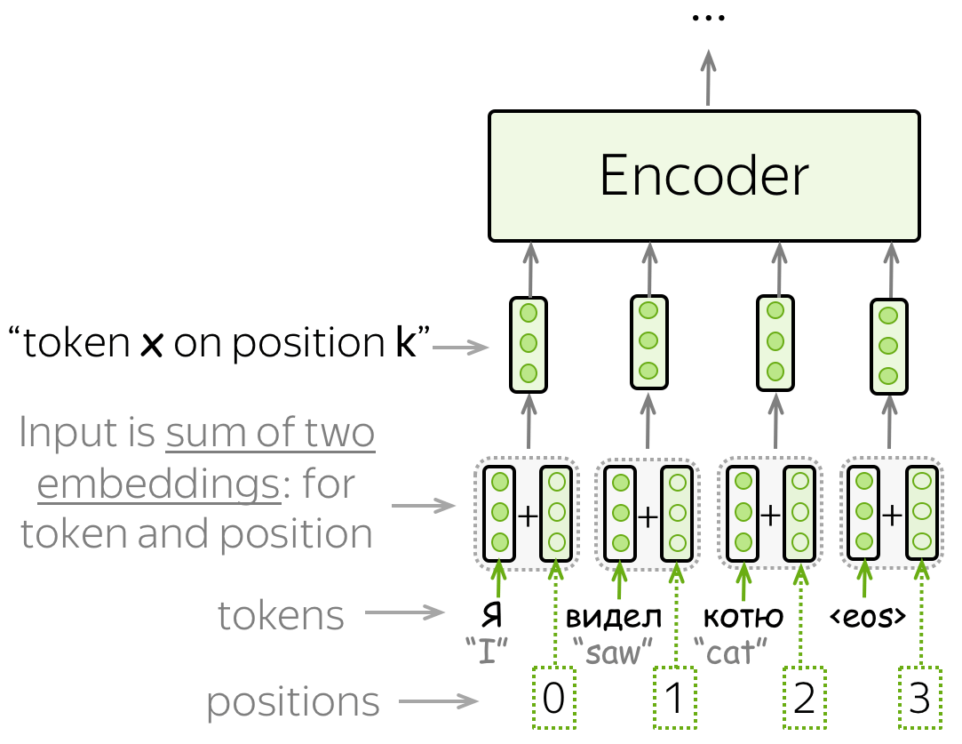
Issues? (1)
We need to keep track of word order in the sentence…
Positional encoding.
Lena-voita

Slide 16
Issues? (2)
Word2vec was trained on a its own corpus (Google News) in advance. Is this a problem? Can we do better?
Learn the word embeddings!
Lena-voita

Slide 17
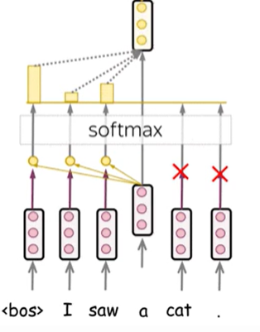
Issues? (3)
When we are training, the decoder should only look at the past
Use “masked” attention!
Lena-voita

Slide 18
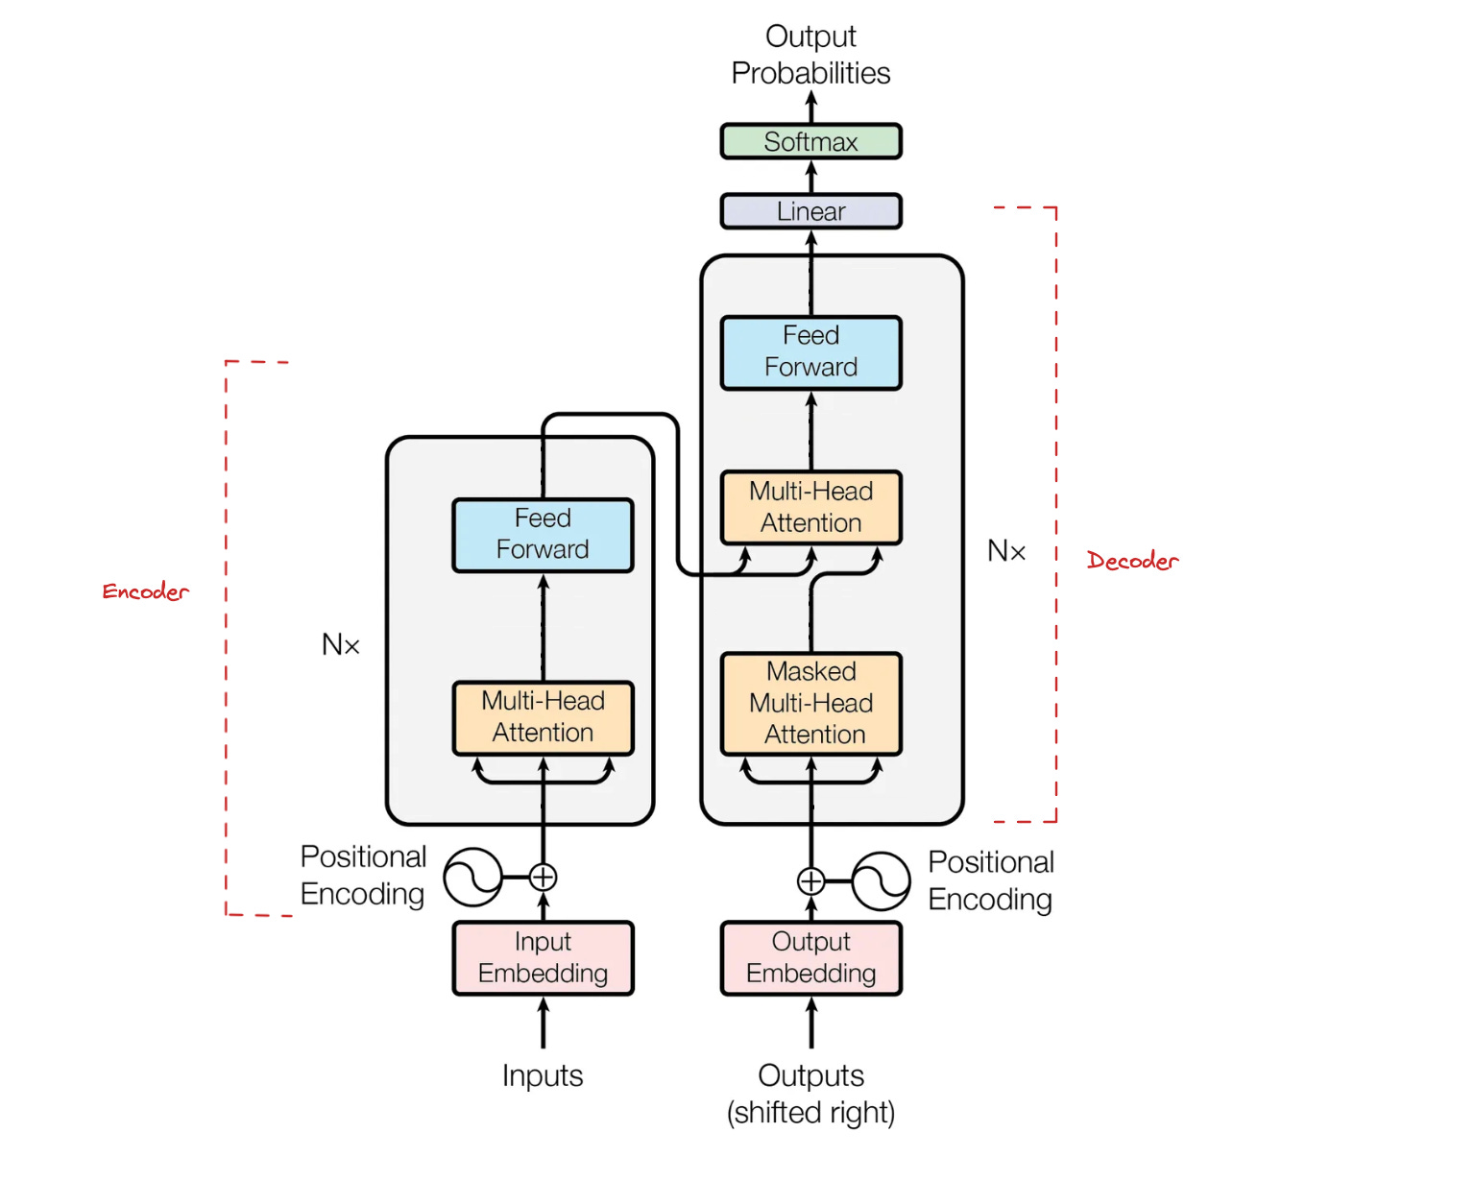
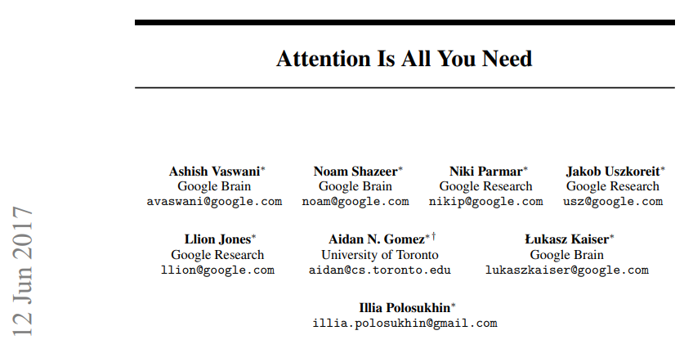
The Transformer is born!
Javinkarla
Notes:
https://janvikalra.substack.com/p/explaining-gpt-4s-secret-sauce-transformers

Slide 19
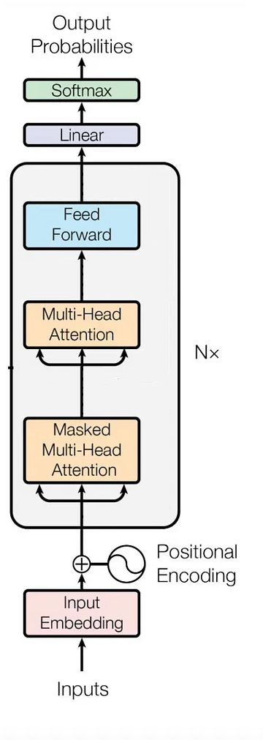
GPT is born!
Javinkarla

Slide 20
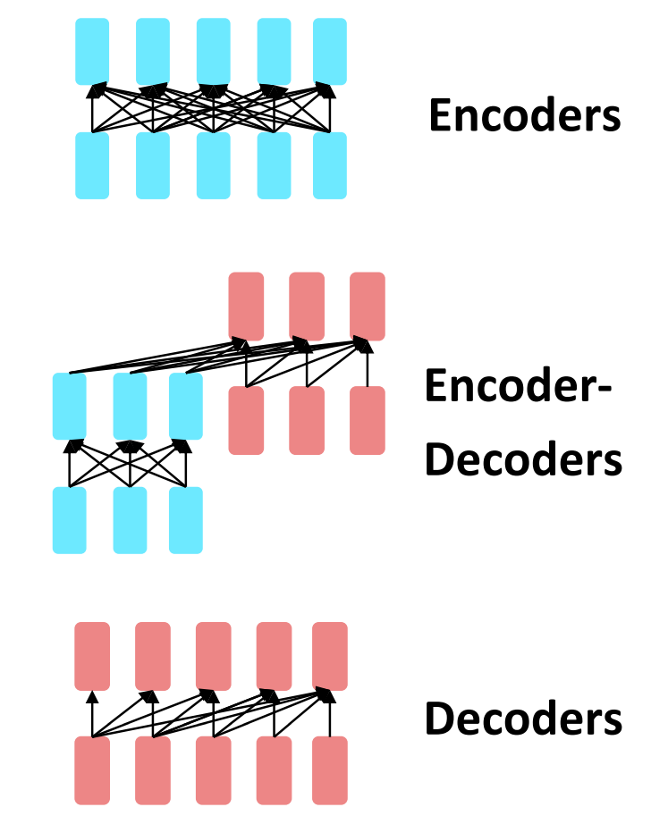
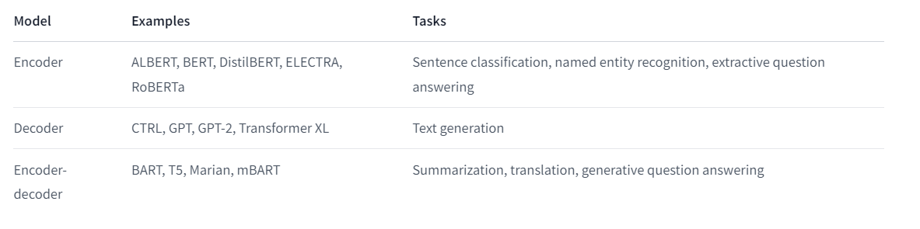
Model type summary
What is each one good for…
Javinkarla
Notes:
https://huggingface.co/learn/nlp-course/chapter1/9?fw=pt

Slide 21
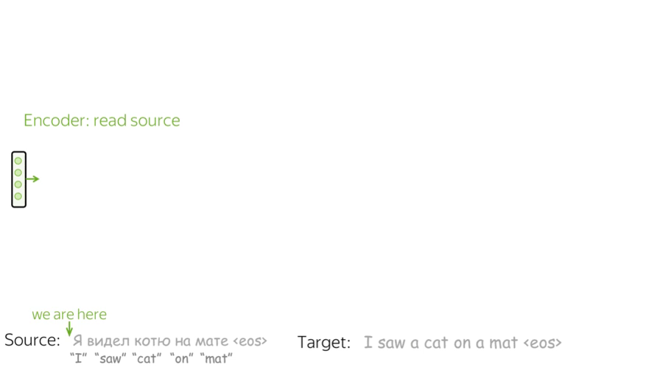
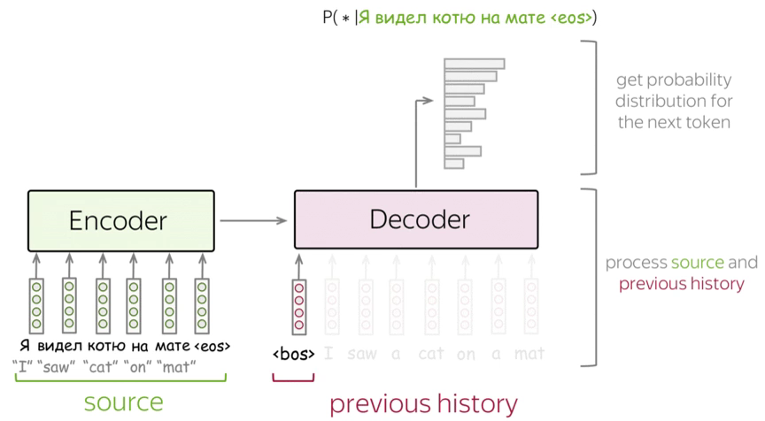
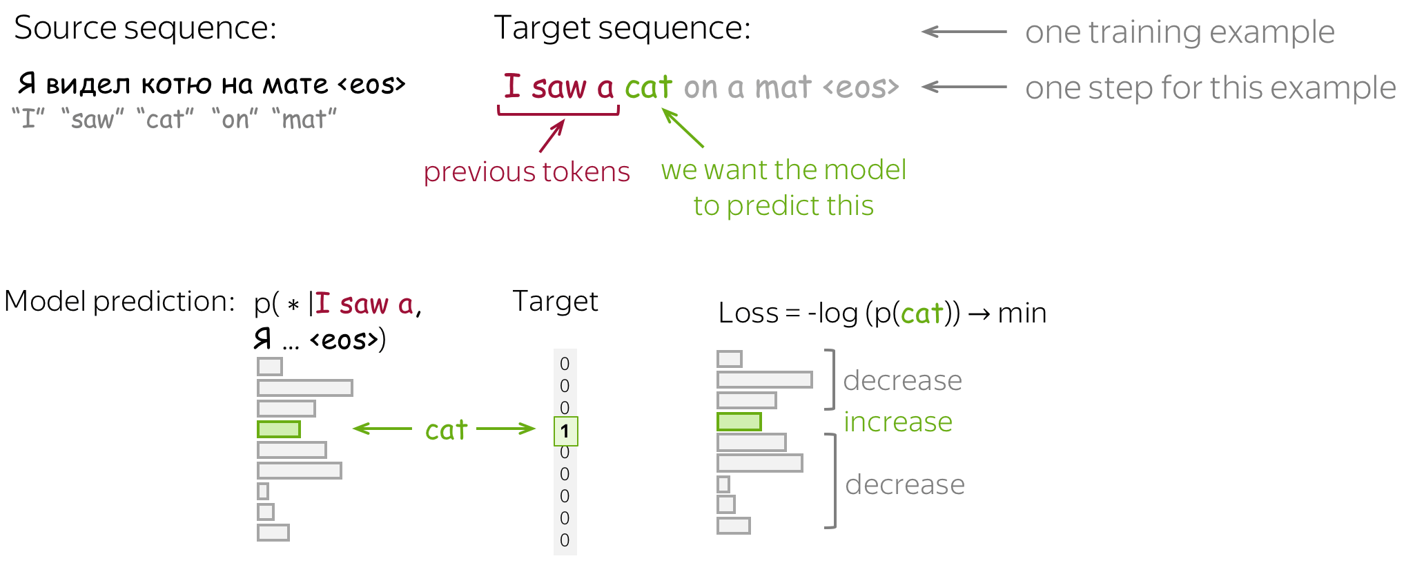
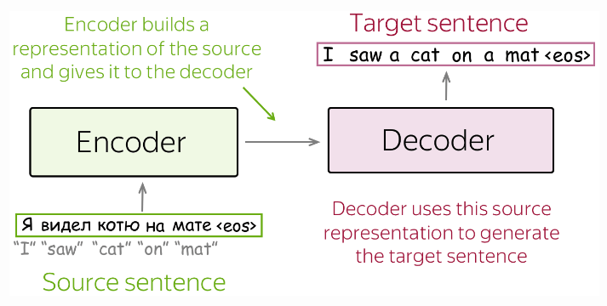
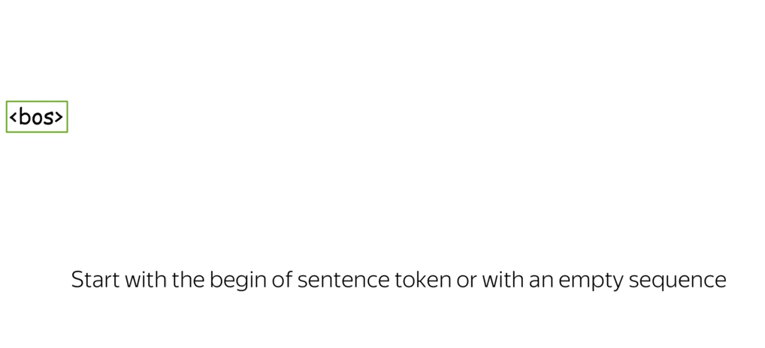
Encoder decoder

Slide 22
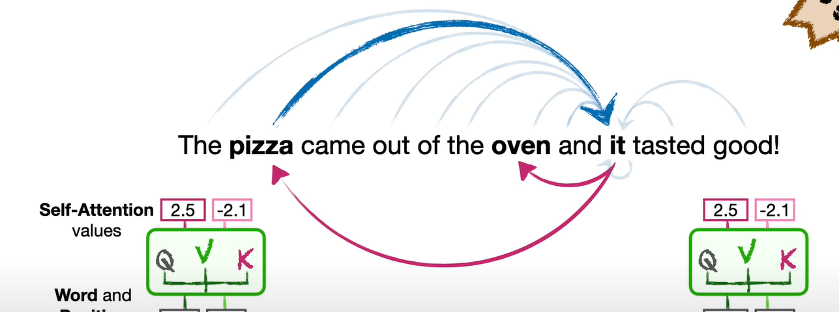
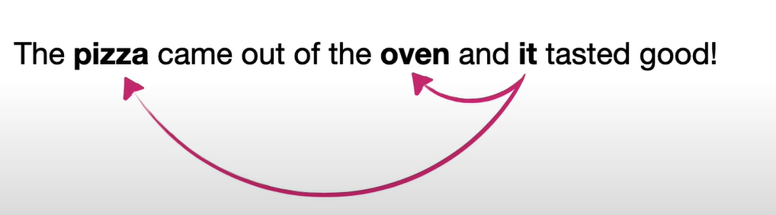
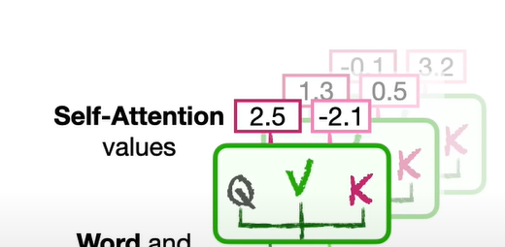
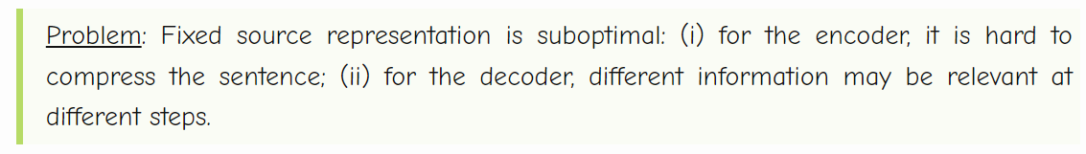
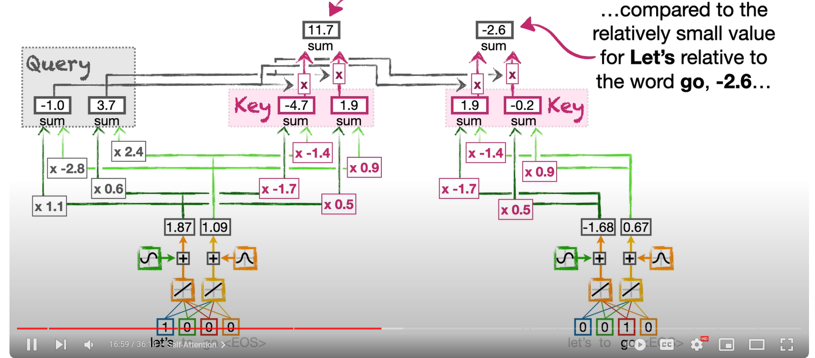
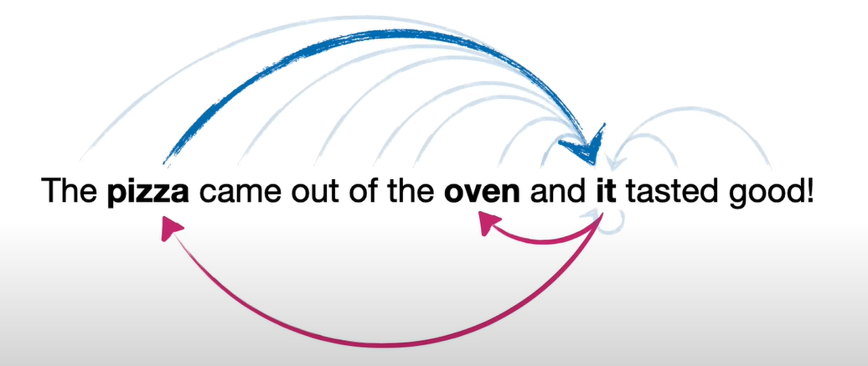
Attention
Notes:
Transformers act in parallel.

Slide 23
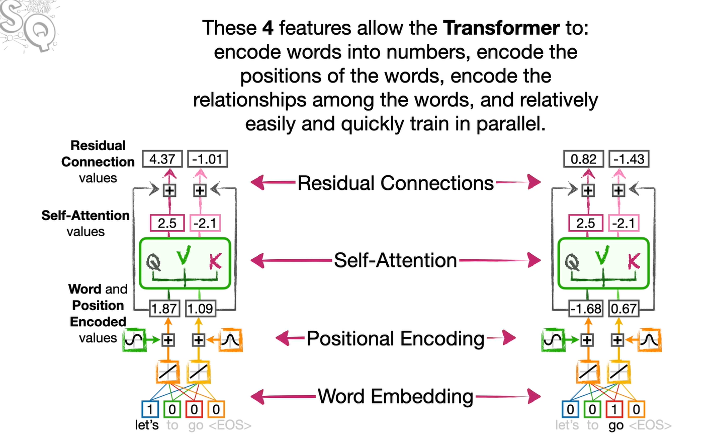
Attention
Notes:
Transformers act in parallel.

Slide 24
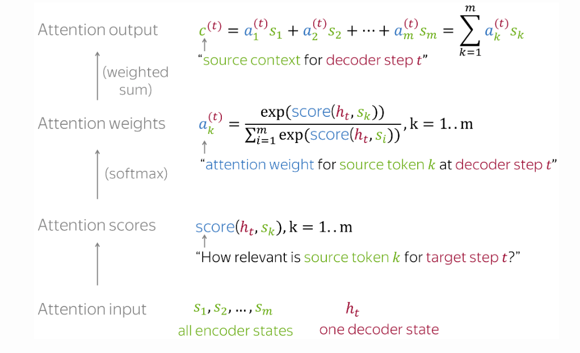
Attention

Slide 25
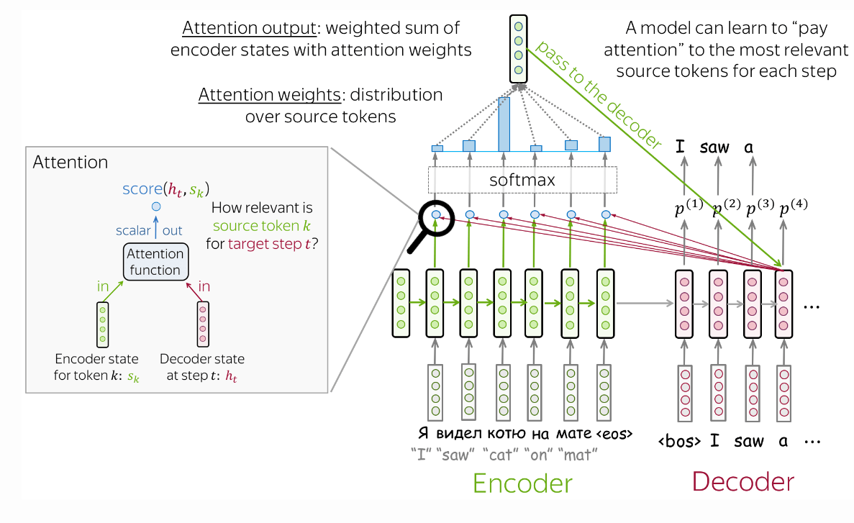
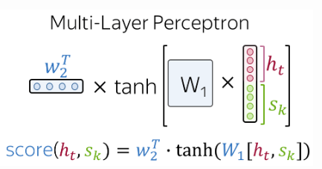
Attention

Slide 26
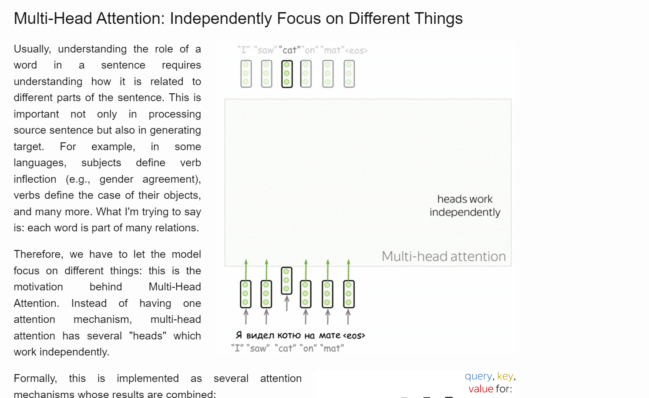
Attention
Notes:
It all happens in parallel (not sequential)

Slide 27
Attention
Instead of cramming everything in the embedding, how about we keep track of the words (tokens) to pay attention to?
Attention is all you need 2017
--→ transformer.
Notes:
- it decides which source parts are more important. In this setting, the encoder does not have to compress the whole source into a single vector - it gives representations for all source tokens (for example, all RNN states instead of the last one).

Slide 28
Models in the wild

Slide 29
Bi directional transformer
Bert

Slide 30
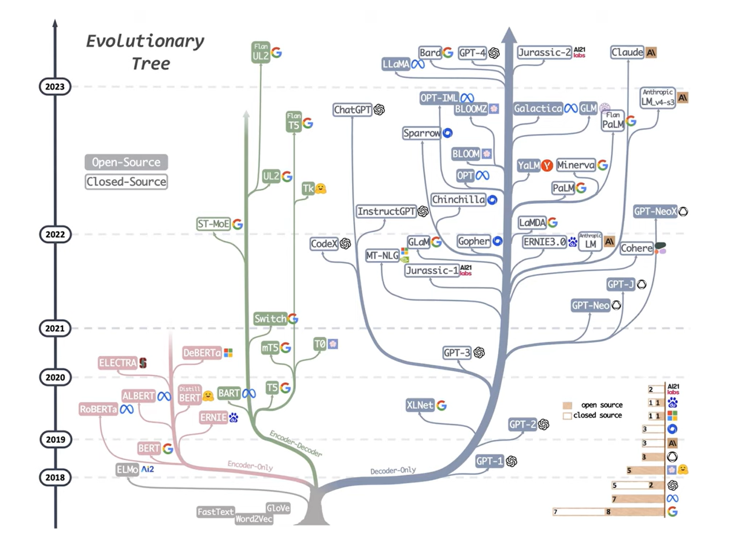
Why so many?
Yang et al.
Where do the differences come from?
Data.
Model type and size.
Hyperparameters (context size, embedding size,…).
Training process (the cost function, fine-tuning, human feedback, etc.).

Slide 31
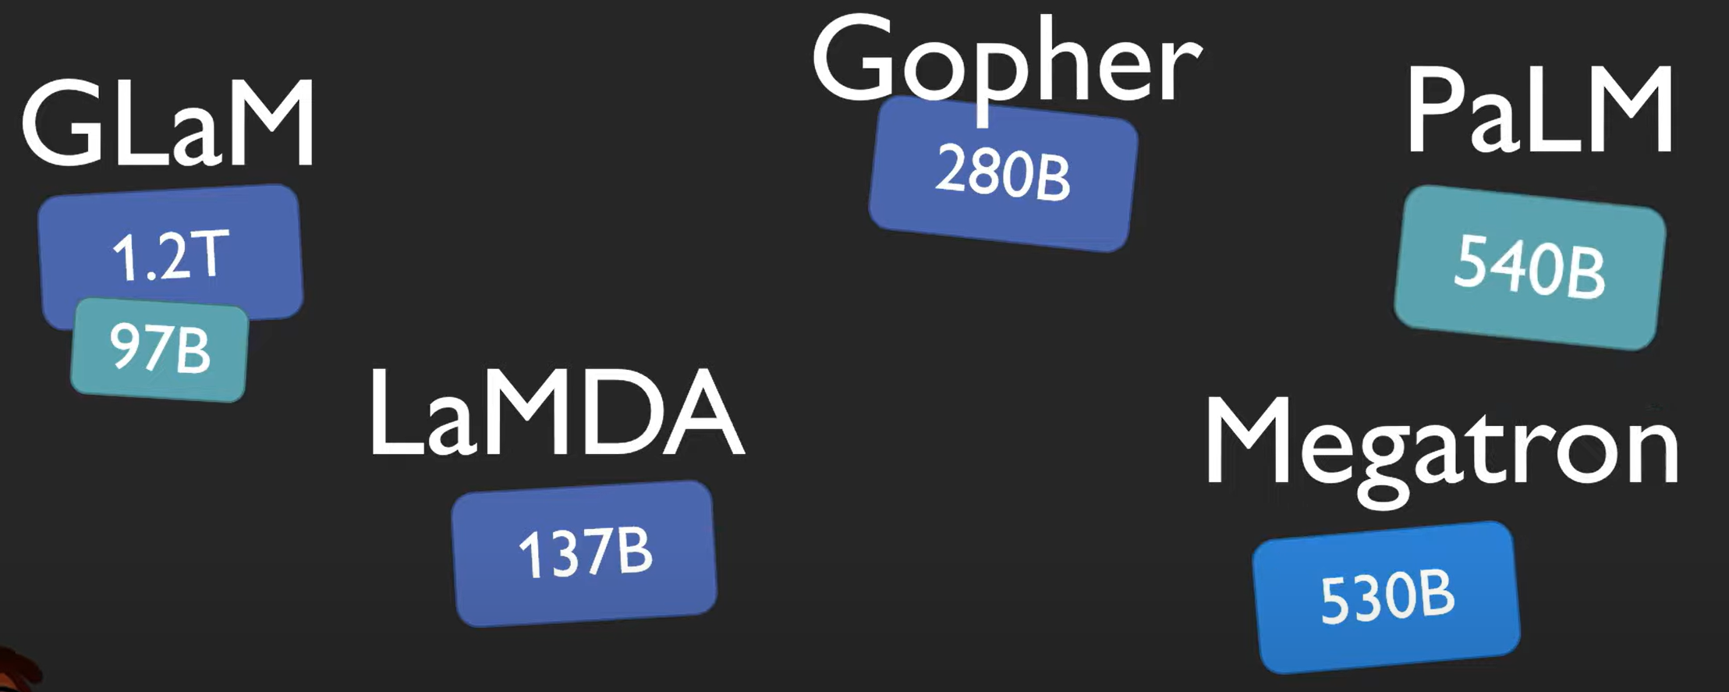
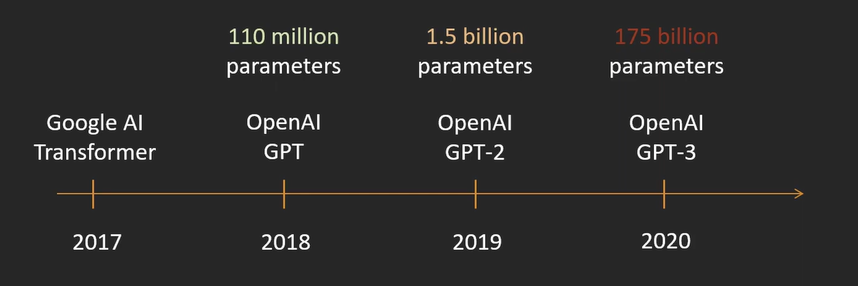
The GPT evolution…
1.76 Trillion…
OpenAI
GPT-4
2023
AI Coffee Beak with Letitia
Book Corpus
WebText
1,038 books (around 74M sentences and 1G words) of 16 different sub-genres (e.g., Romance, Historical, Adventure, etc.)
Common Crawl + ...
Over 240 billion pages. Petabytes of data.
????
Notes:
Larger and larger data (increase data is all you need)

Slide 32
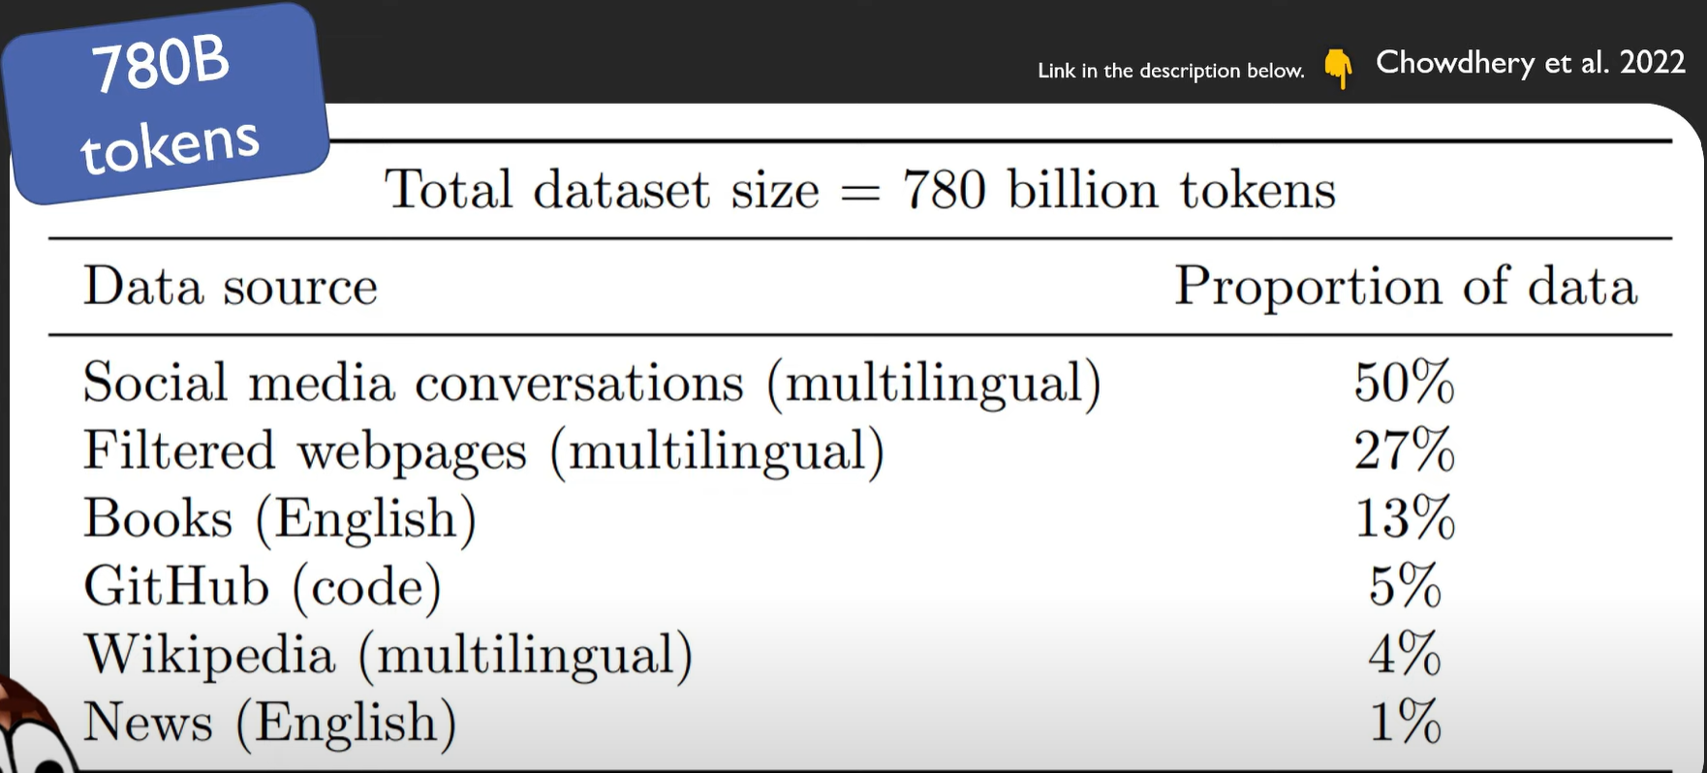
The GPT evolution…
AI Coffee Beak with Letitia
Notes:
Larger and larger data (increase data is all you need)

Slide 33
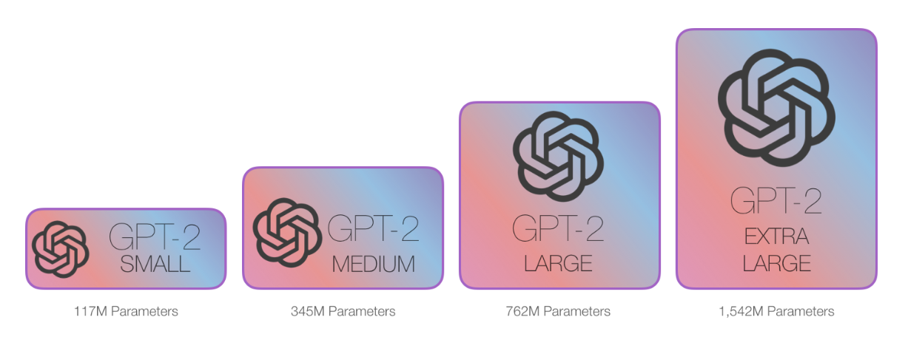
Different model sizes
Jay Alammar

Slide 34
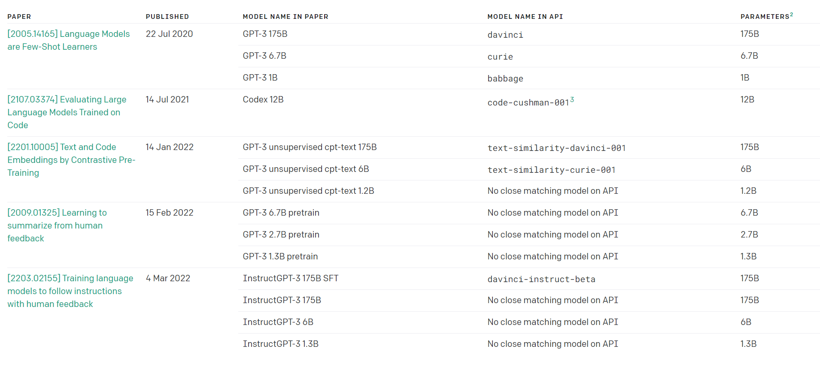
Different model sizes
OpenAI model reference
HuggingFace tasks
HuggingFace models

Slide 35
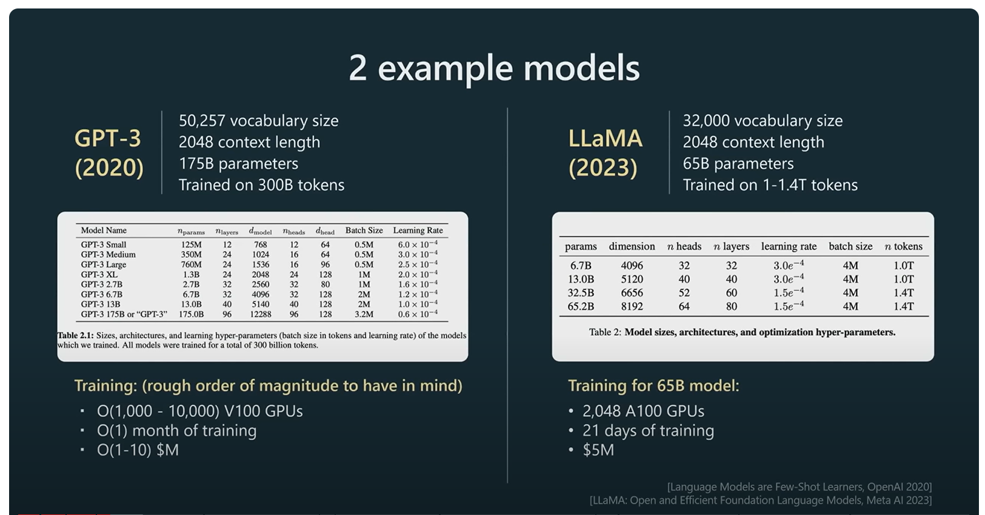
How much training does it take?

Slide 36
Let’s play!
https://tinyurl.com/2p9e9kke

Slide 37

Where do I find these models?
There are many packages that have implementations of these models.
Huggingface is a very commonly used one.

Slide 38
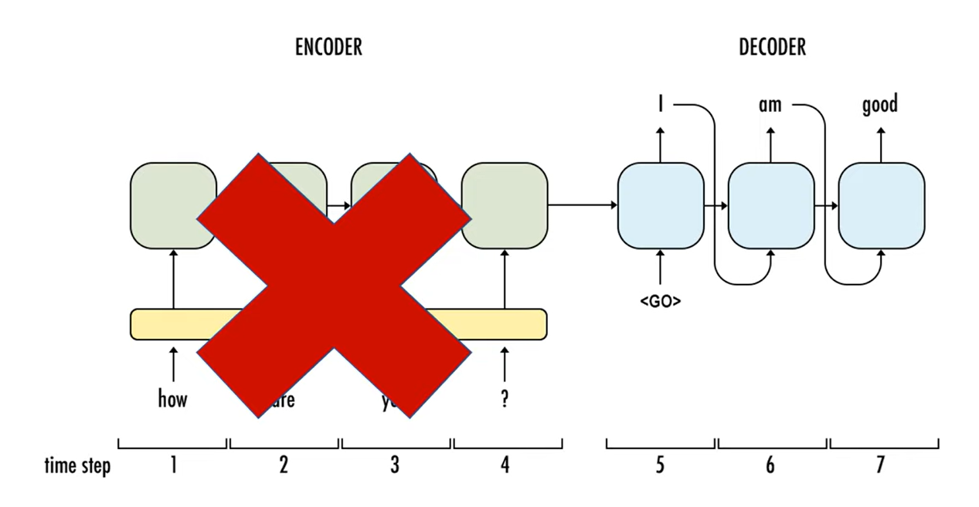
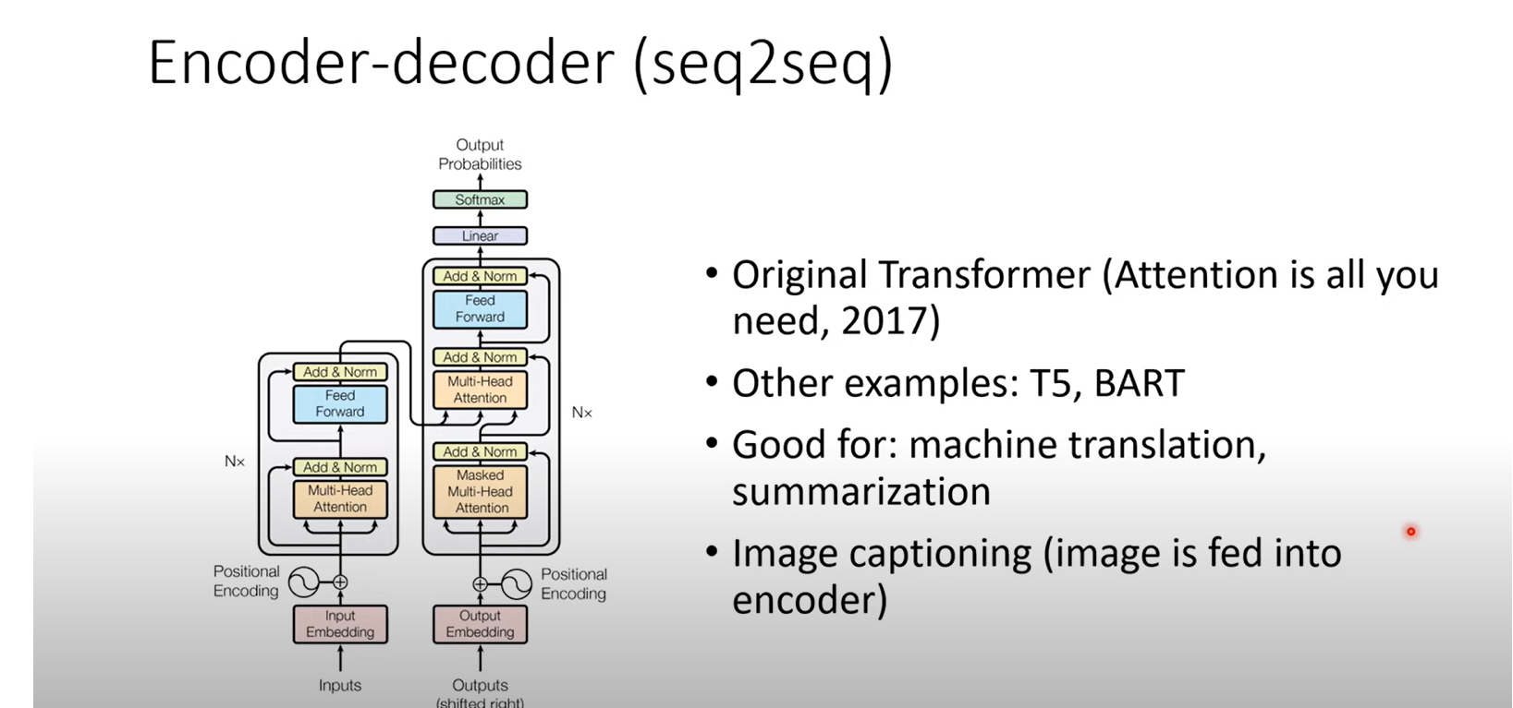
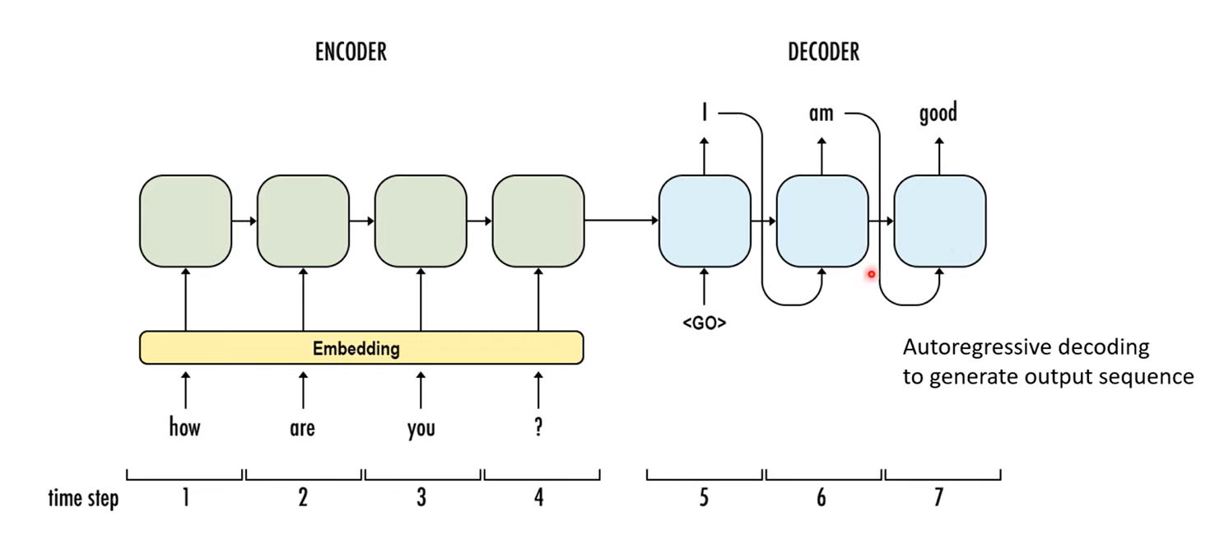
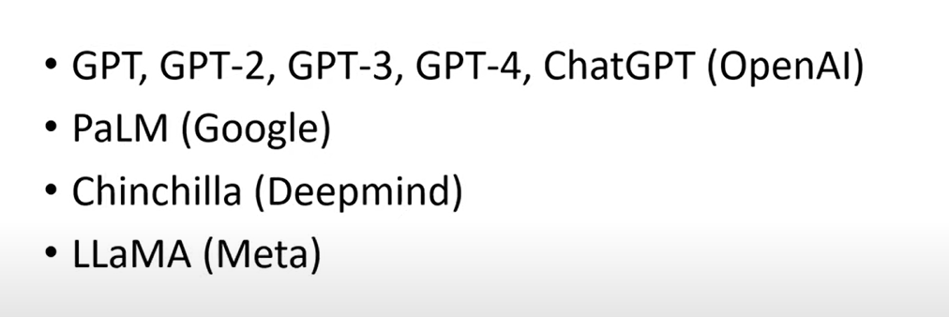
Encoder decoder
Notes:
https://www.youtube.com/watch?v=wOcbALDw0bU

Slide 39
Transfer learning

Slide 40
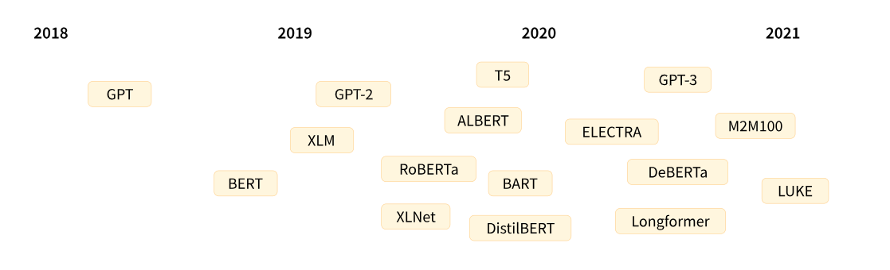
history
https://huggingface.co/learn/nlp-course/chapter1/4?fw=pt

Slide 41
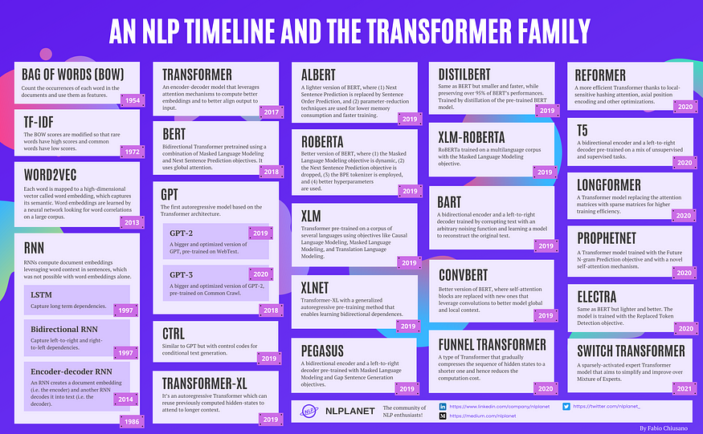

Slide 42
Huggingface Demo

Slide 43
pipeline

Slide 44
Zeroshot classification
https://huggingface.co/learn/nlp-course/chapter1/3?fw=pt

Slide 45



Fewshot learners
https://twitter.com/michaeltefula/status/1285505897108832257?ref_src=twsrc%5Etfw%7Ctwcamp%5Etweetembed%7Ctwterm%5E1285505897108832257%7Ctwgr%5E5cd0b6a1db7ab890f2086fa4f9f08532608ce6cc%7Ctwcon%5Es1_&ref_url=https%3A%2F%2Fwww.legalcomplex.com%2F2020%2F09%2F07%2Fwill-lawyers-be-replaced-by-gpt-3-yes-and-heres-when%2F
Notes:
What does it really mean?
GPT-3: Language Models are Few-Shot Learners (Paper Explained): https://www.youtube.com/watch?v=SY5PvZrJhLE

